Slide 1
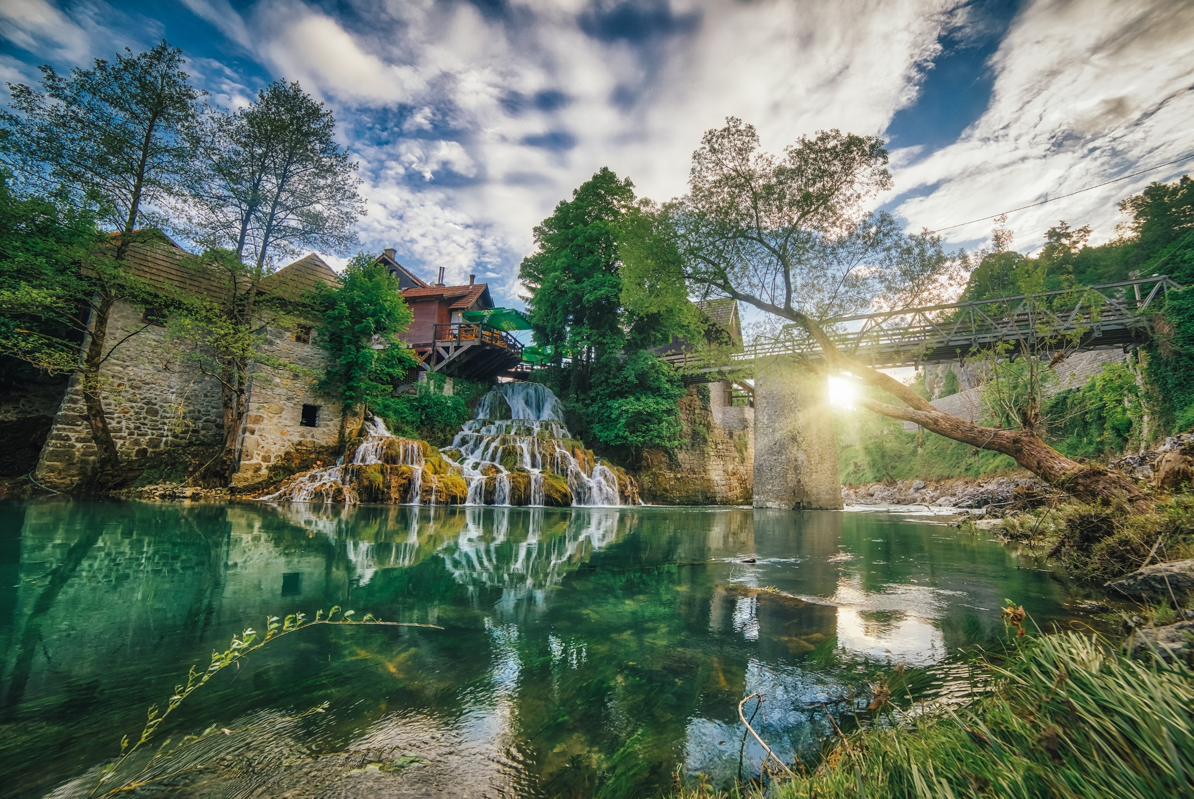
SLUNJ, CROATIA
Osnovna škola Slunj

Slide 2
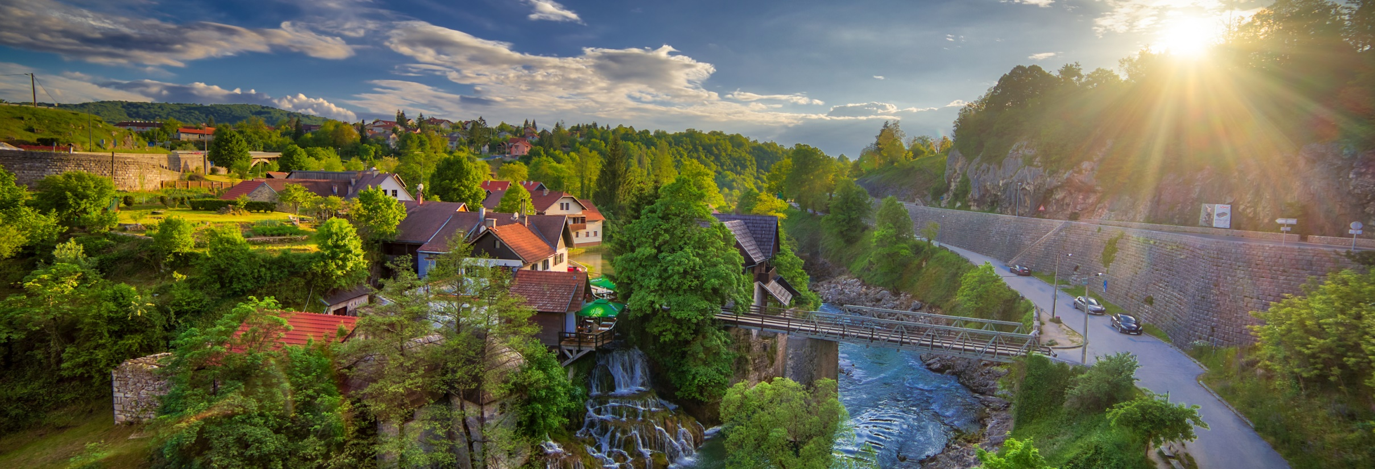
LOCATION
located in the mountainous part of central Croatia,
near Plitvice Lakes National Park,
on the rivers Korana and Slunjčica
school; OŠ Slunj, in the center of the town
surrounded by other important institutes

Slide 3
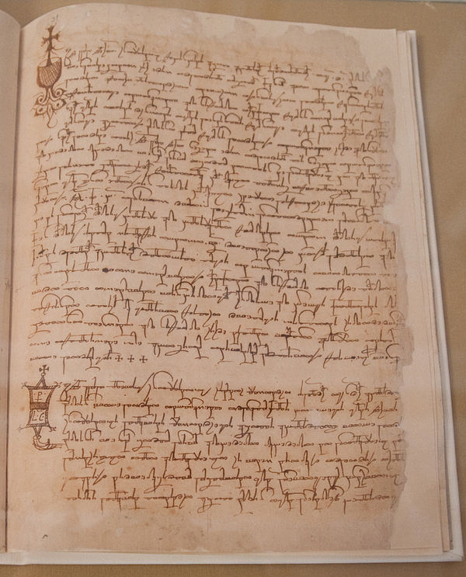
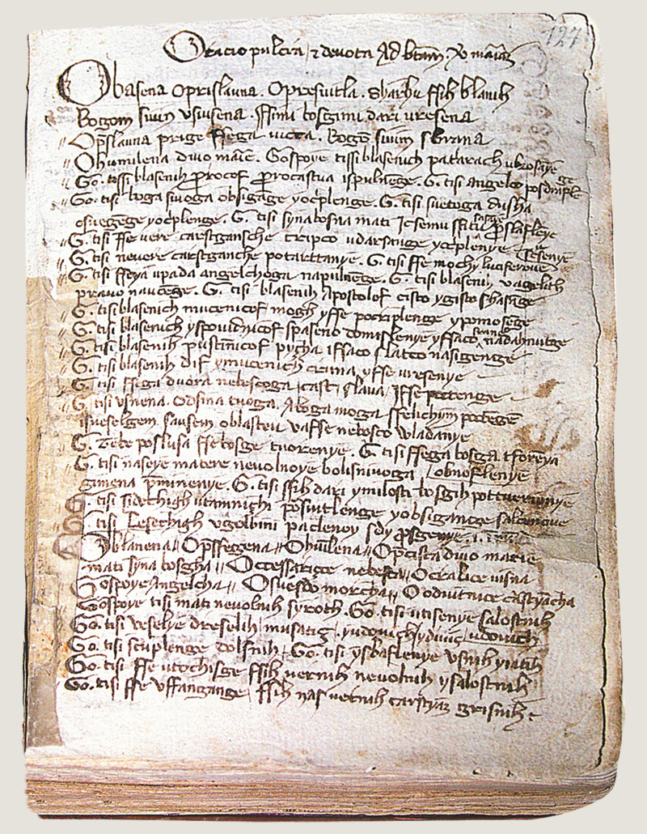
LANGUAGE
Croatian, spoken by everyone in Croatia
different formations for individual parts of the country
existed since ancient times
various evidences of its existence in the past, such as documents, books…

Slide 4
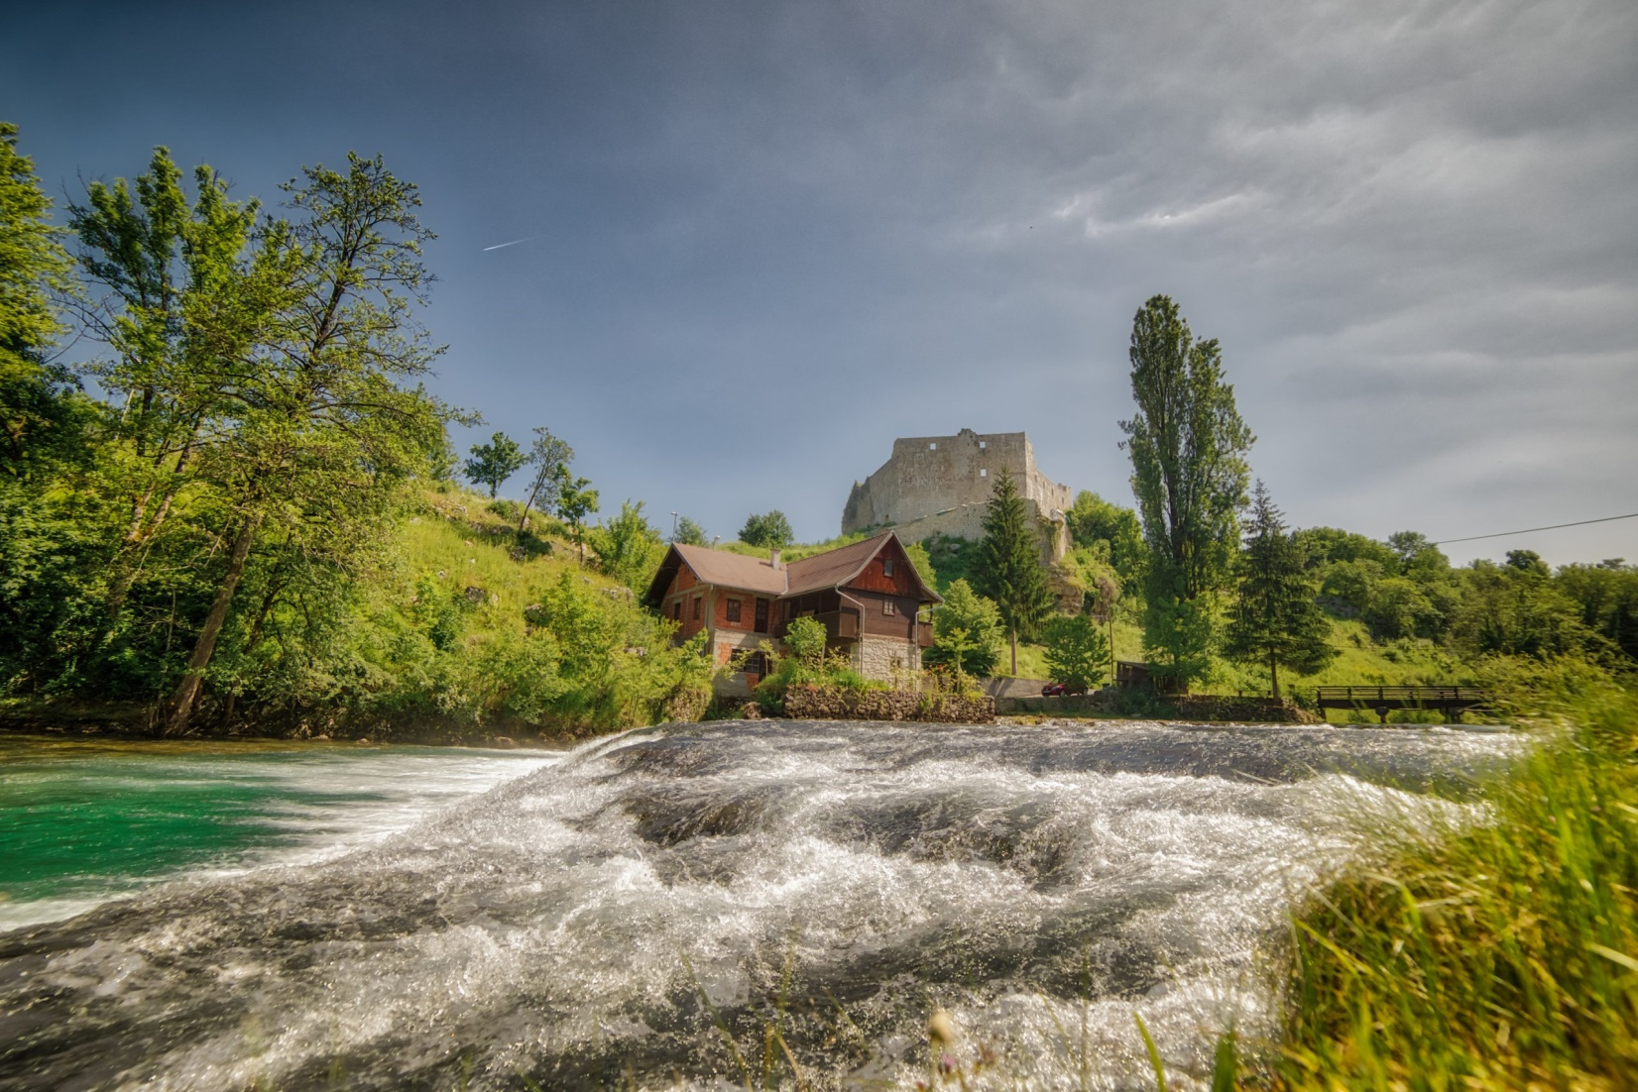
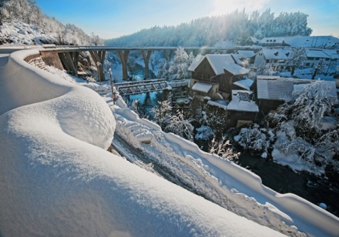
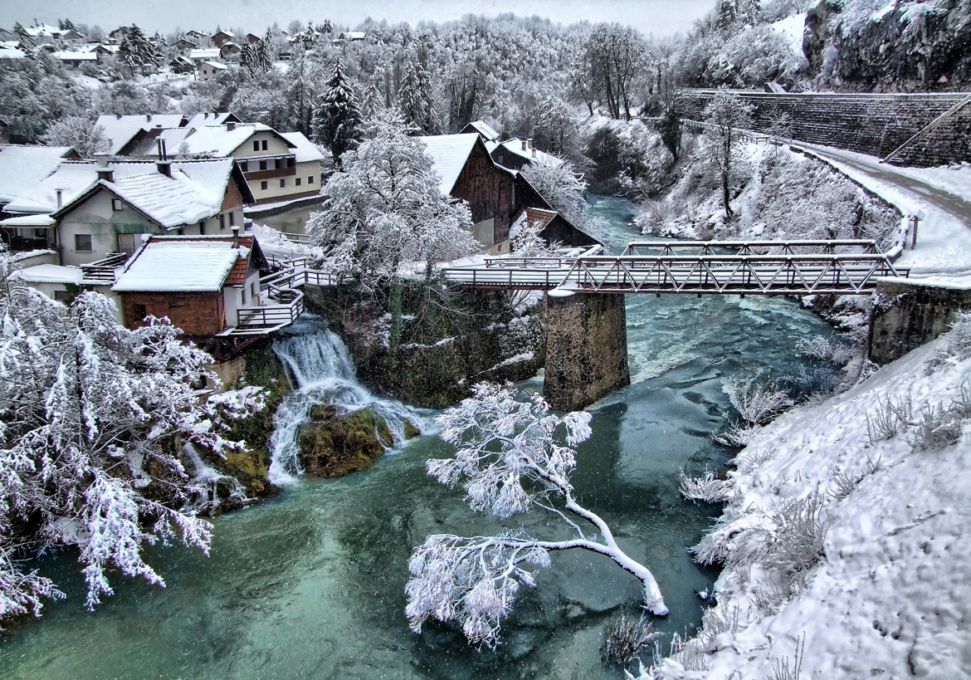
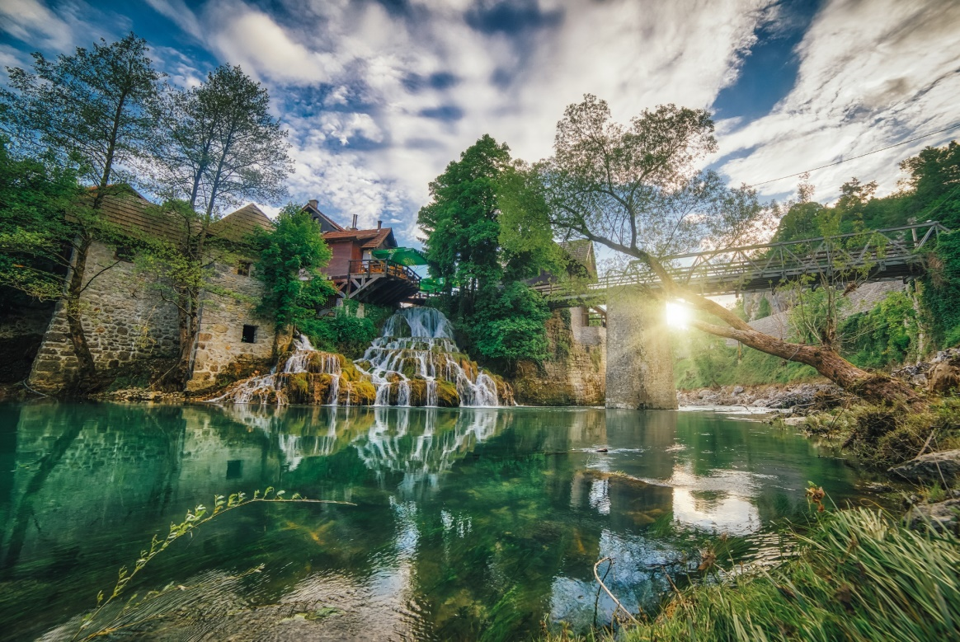
CLIMATE
summers; hot and rainy,
winters; cold and relatively snowy
the overall climate; favorable for agriculture and rural areas of the town

Slide 5
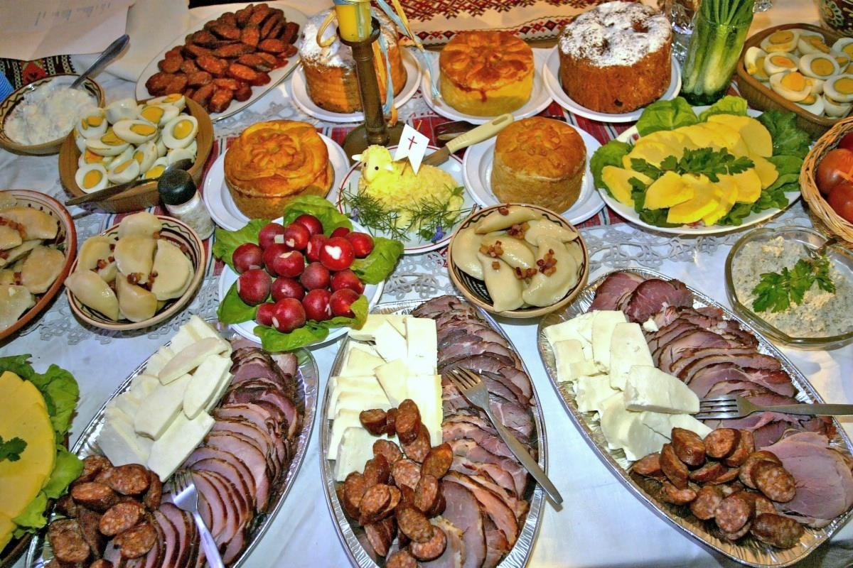
TRADITIONAL FOOD
The most prepared meals; masnica, uštipci, homemade meat; sausages, bacon…, sarma, grah and more

Slide 6
WHAT IS SLUNJ FAMOUS FOR
Milan Neralić- a Croatian fencer born and lived in Slunj, the first Croatian Olympian, the first Croatian medal winner at the Olympic Games
bananas- in the 1980s everyone went to Slunj to buy banans, they were „the best”, there was a tv advertisement about them
Rastoke- famous, beautiful waterfalls located in the pure middle of Slunj

Slide 7
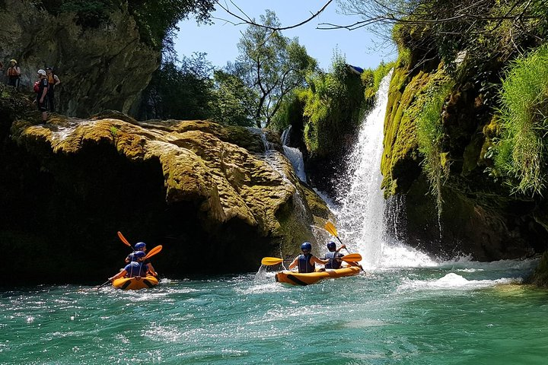
THE BEST 2 ACTIVITIES TO DO IN SLUNJ
KAYAKING
you can go kayaking on Mrežnica, a couple kilometers away from Slunj
QUAD TOUR
some places offer a quad tour all over Slunj, through the woods, rural areas, through the town etc.

Slide 8
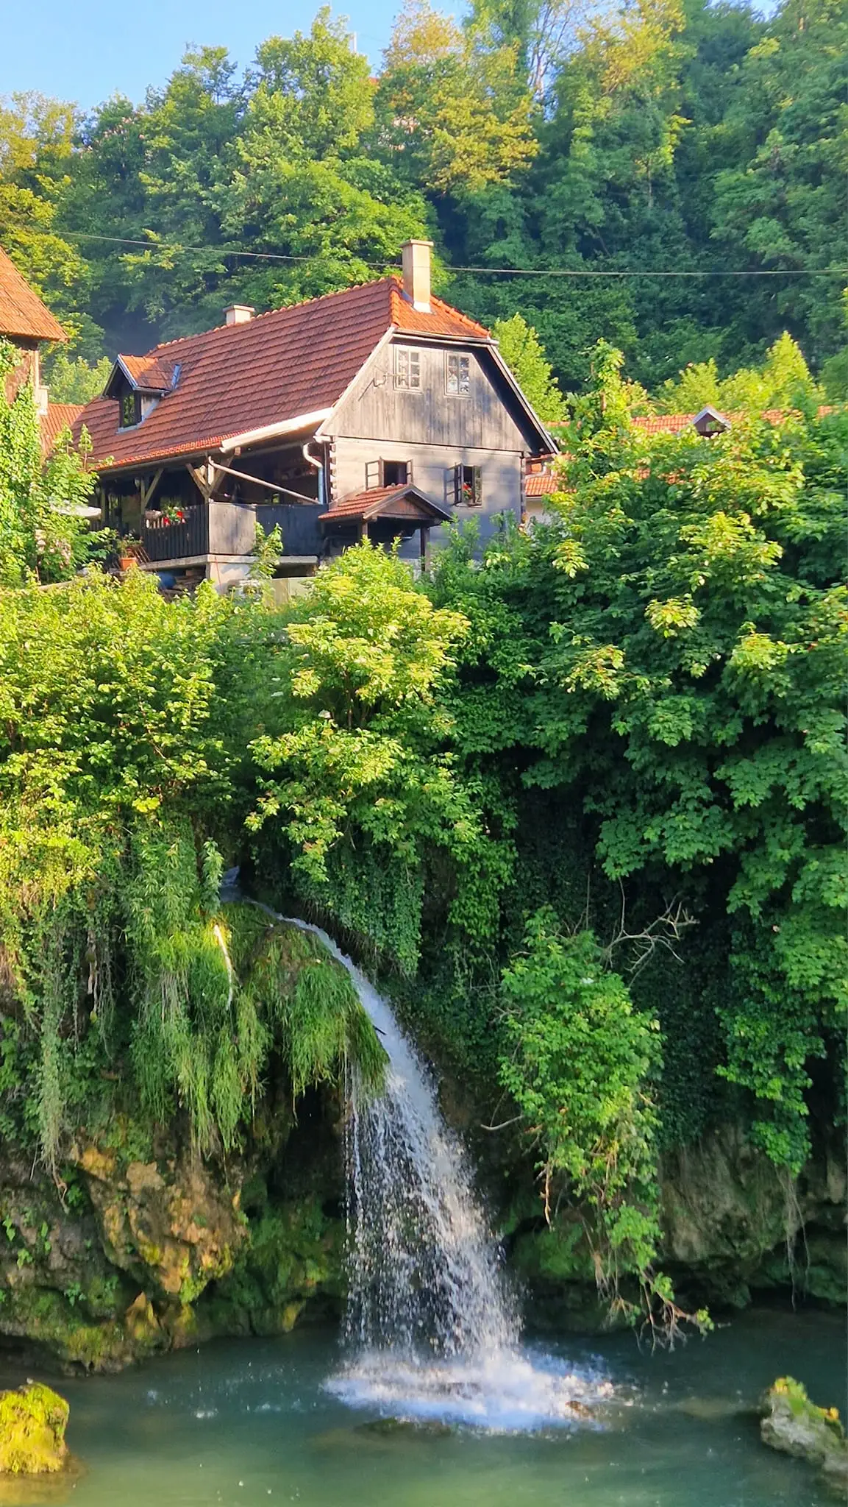
#1
VOTED #1 AS THE BEST RURAL DESTINATION IN THE WORLD 2023.

Slide 9
TRADITIONAL CHRISTMAS CELEBRATION

Slide 10
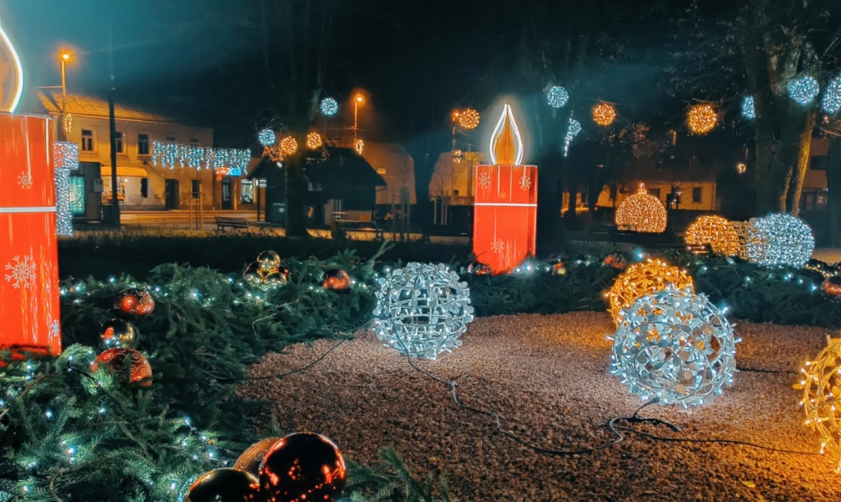
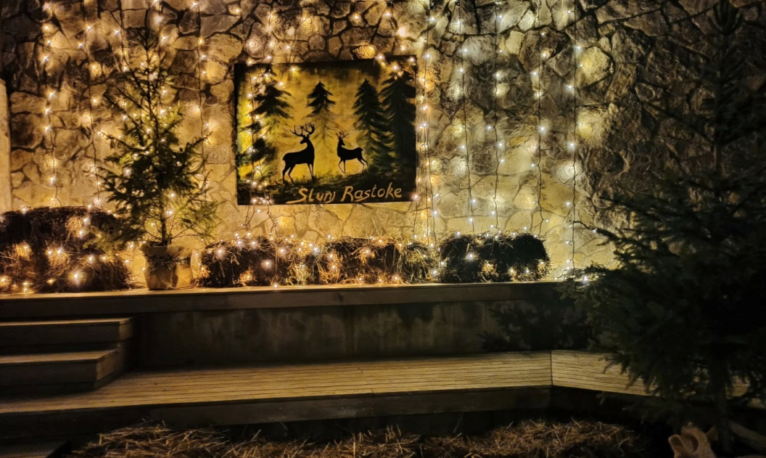
HOW DO WE CELEBRATE CHRISTMAS?
our tradition is to decorate the whole town with christmas decorations
decorating the Christmas tree; the main part of Christmas Eve
baking cookies; kids enjoy decorating them which adds to the festive mood
people prepare a variety of meals; usually a whole pig or a lamb, turkey and grinders and desserts
families go to church together
…

Slide 11
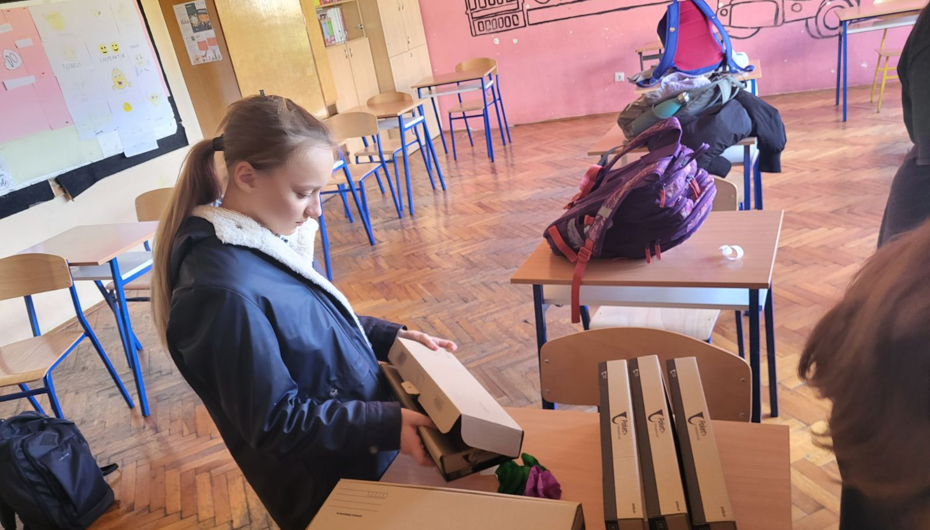
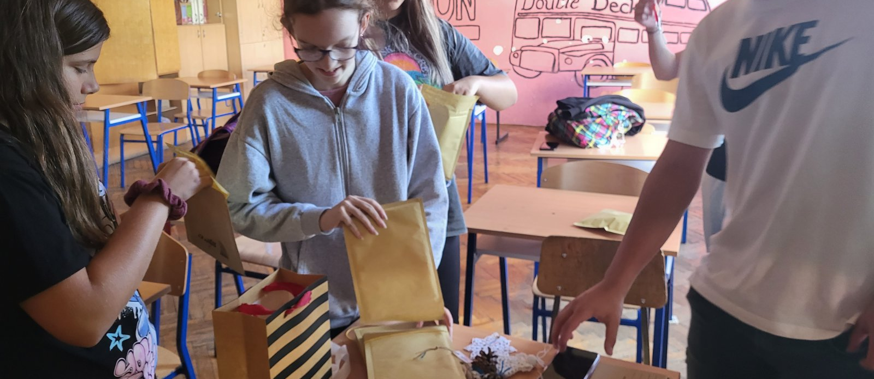
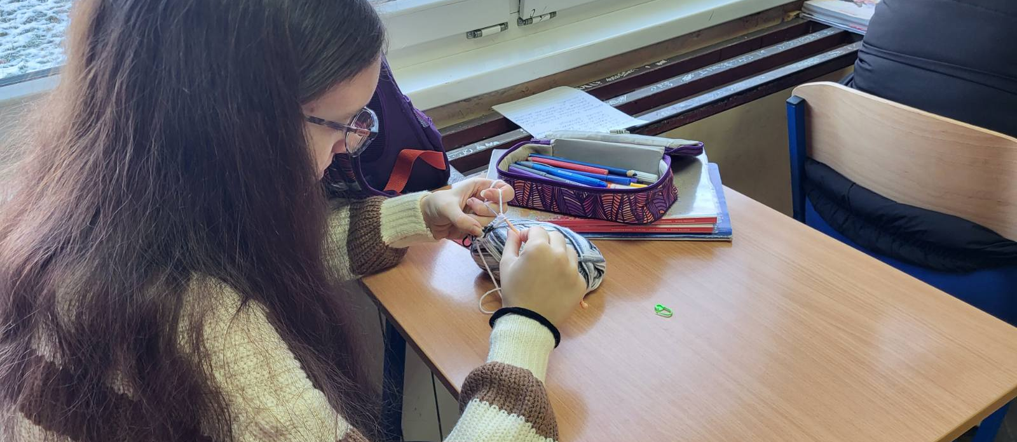

Slide 12
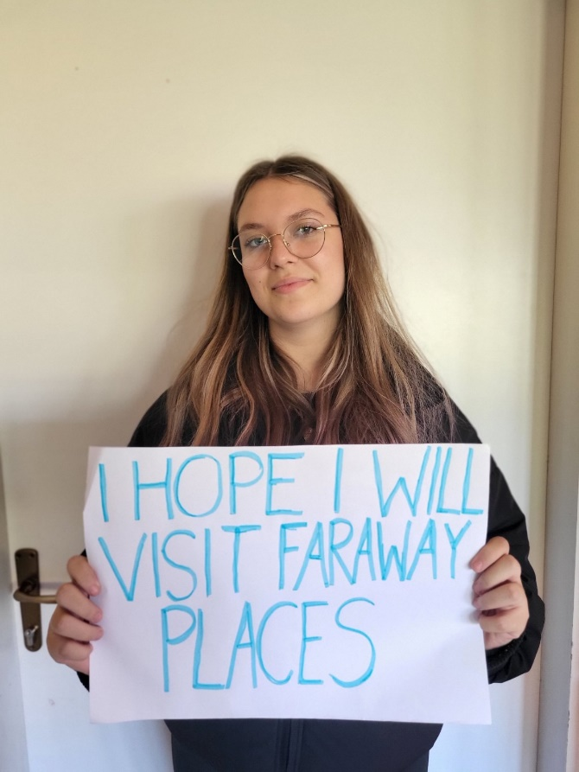
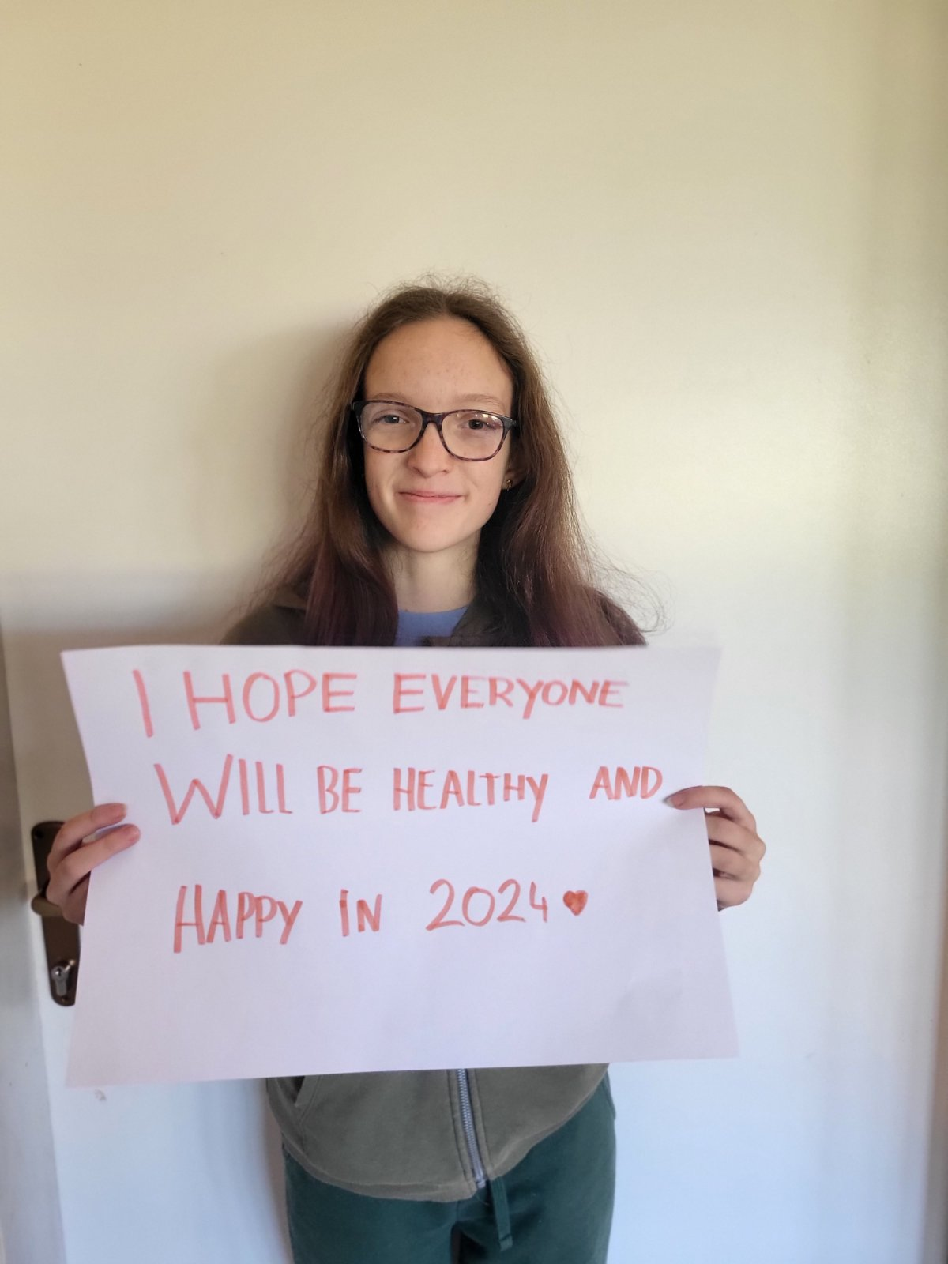
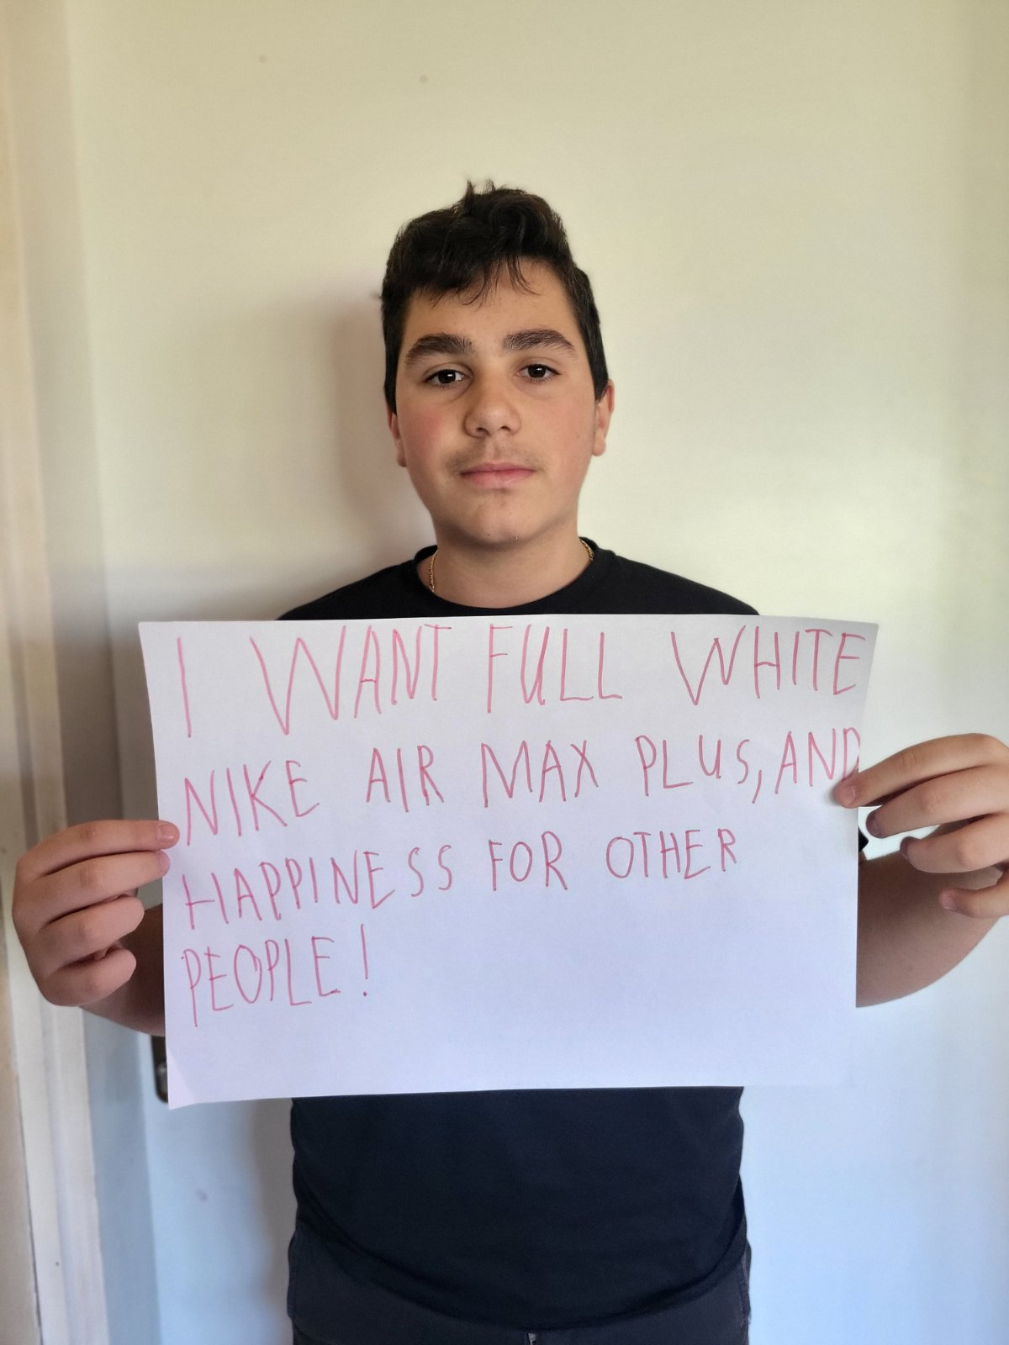
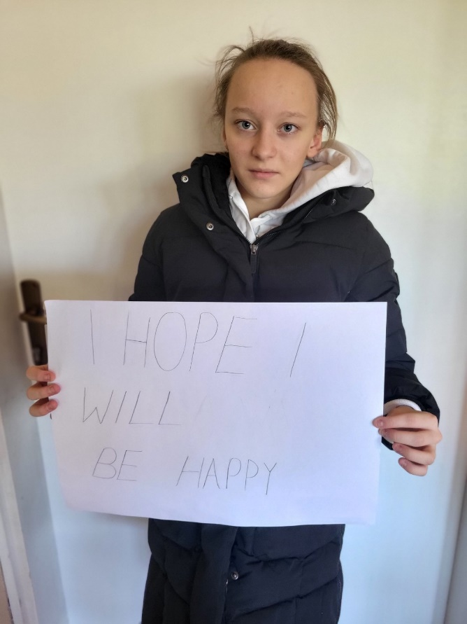

Slide 13
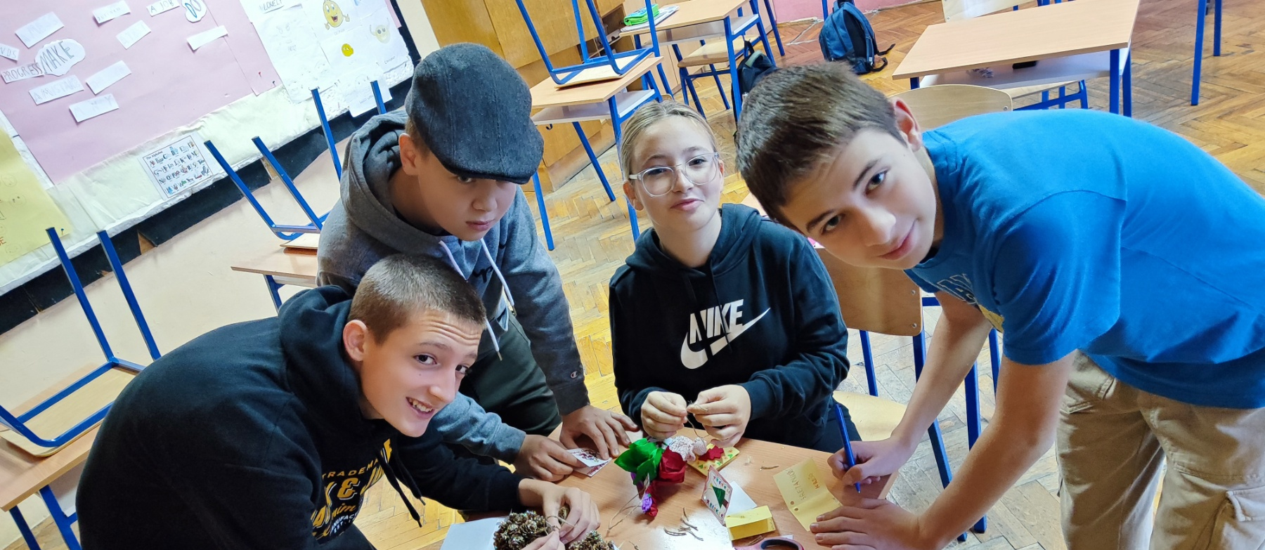
My wish for the new year 2024 is that I am healthy, that my family and friends are well and that we are all happy. That my grades are better and maybe meet some new friends and that we are happy together.
Health for my family,good grades,good governance,a pretty gift for my birthday and Christmas and happy New Year.
I wish this school year will be the best I want to have good grades, meet new friends, be healthy and get some presents from my family. I wish I had more free time that I can spend on something fun: on my friends, parents…I want to have a new room because that will make me really happy .
I wish happiness for all people on earth. I also wish for a new videogame and some clothes.

Slide 14
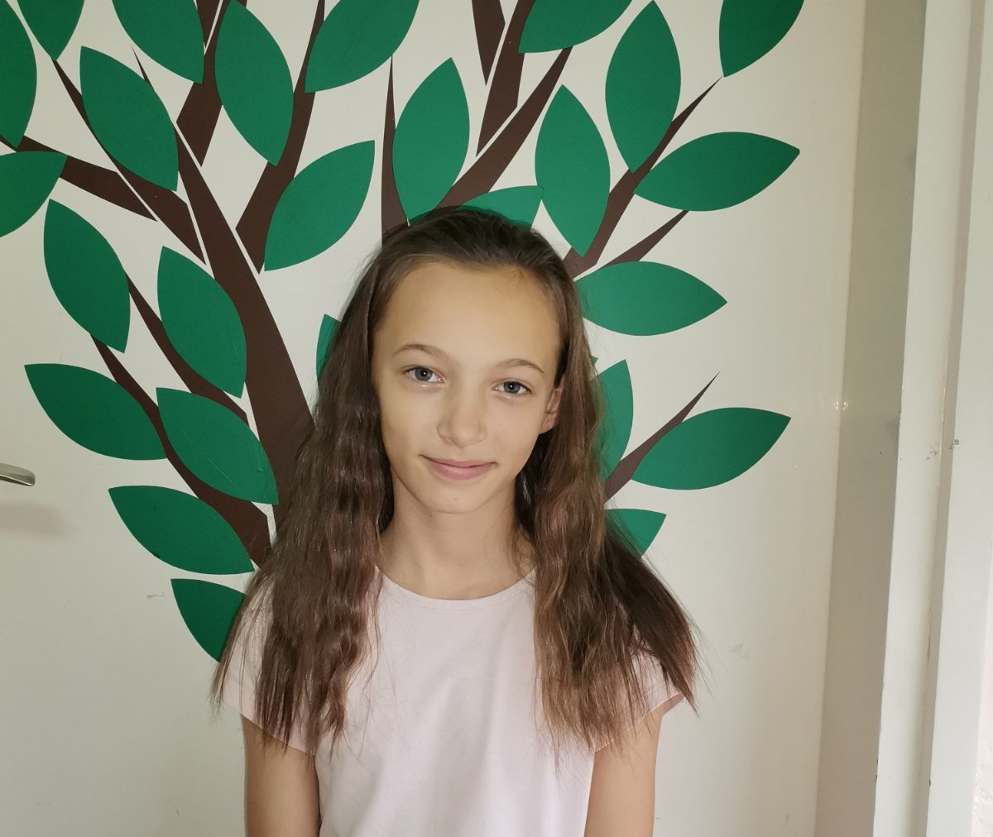
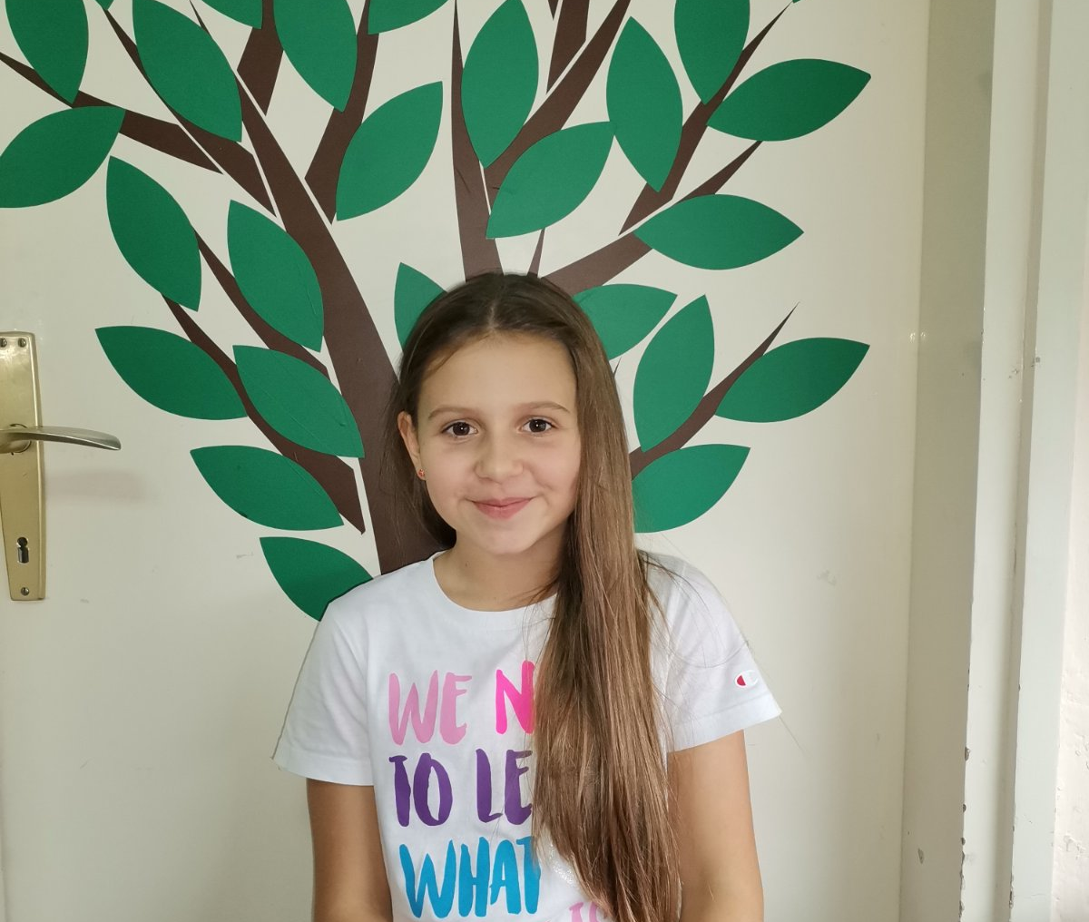
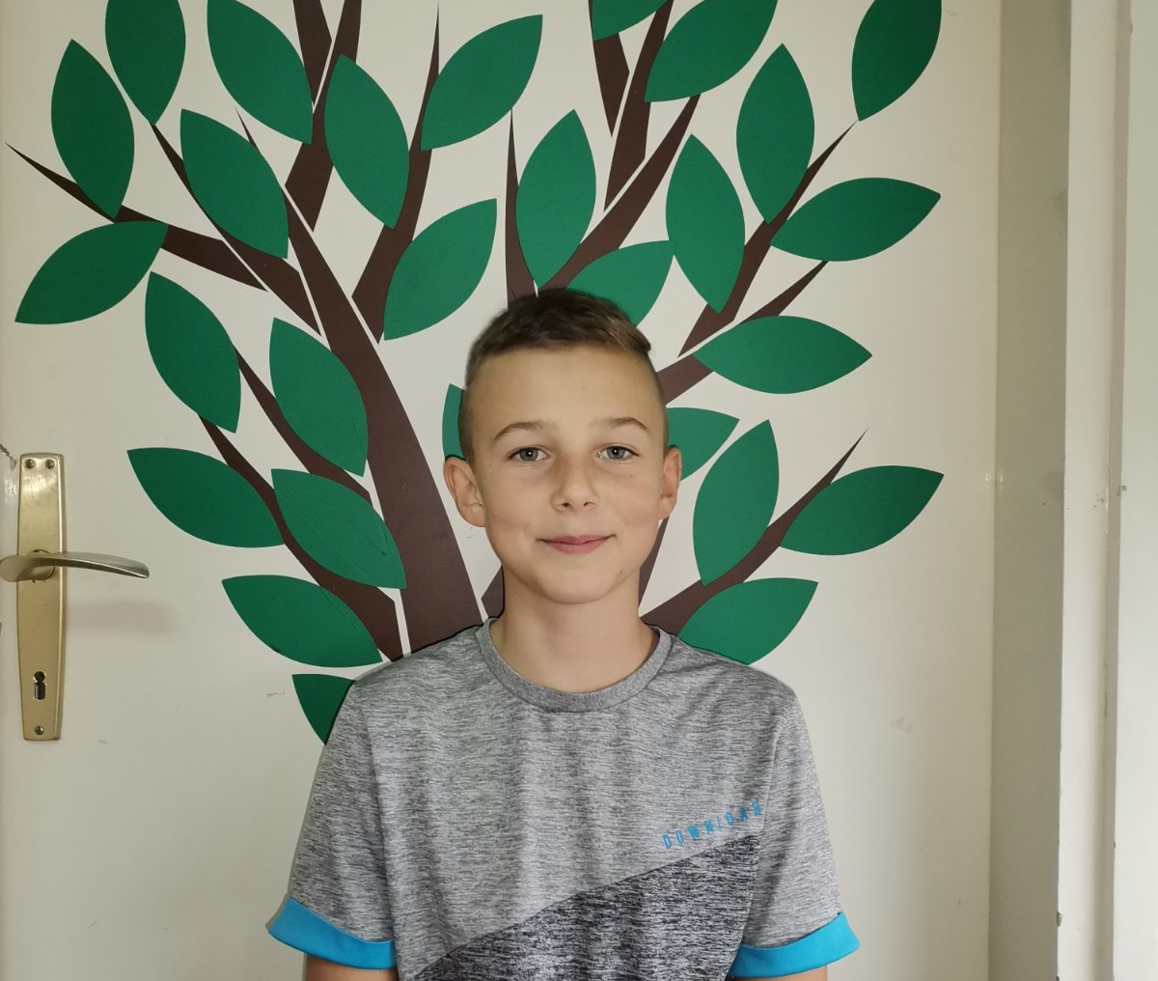
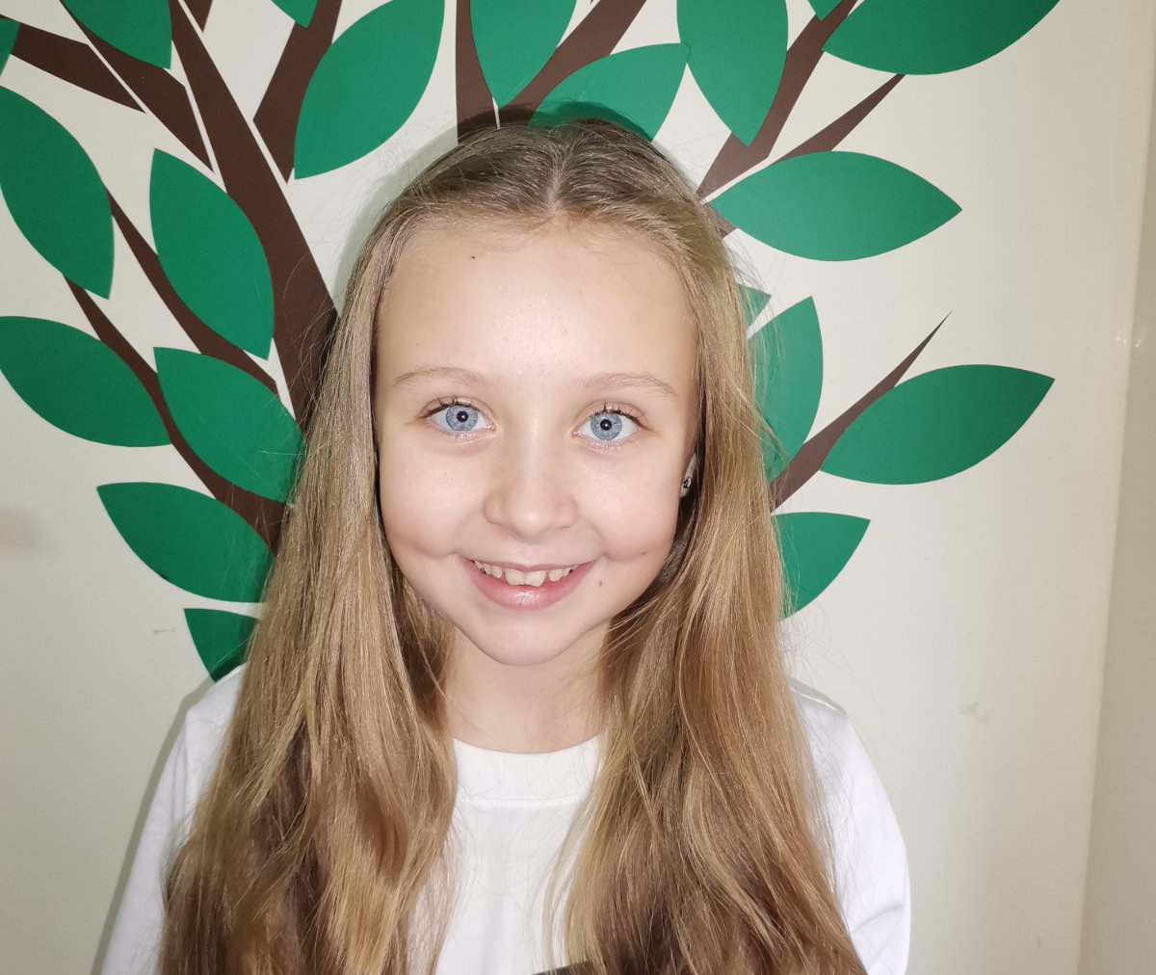
I would like to get a new room (my own room). I wish to be the first in a competition. I would like to be good at playing the violin. I also wish to get more new books, because I like reading.And my final wish is to become famous one day.
I wish my class to go on a field trip to the seaside. I would also like to get a new room in a new flat. I would like to visit Advent in Zagreb. And finally I wish for all As in school./ I would like to get all As in school.
I would like a lot of joy, health, happiness, play…so it will make New Year better. And I would like my grandparents to come from Germany and visit us.
I wish to get a new game named Marvel Spiderman 2 and VR 2. I would like to get all As in school. I wish to visit the USA next year too and to visit the Moon one day. And finally I wish to become a professional football player.

Slide 15
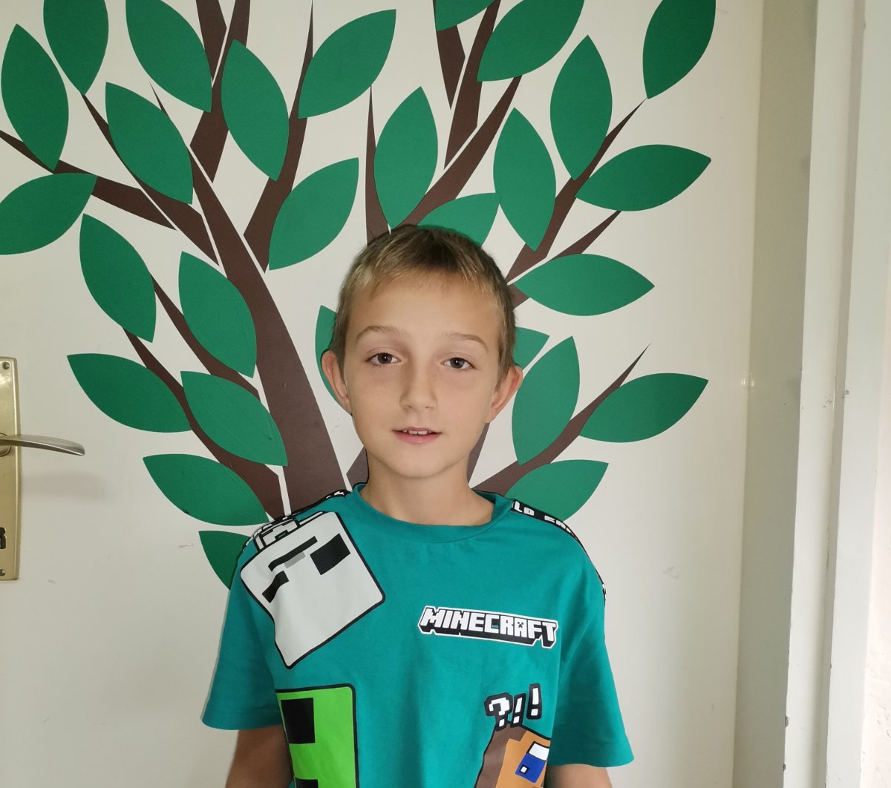
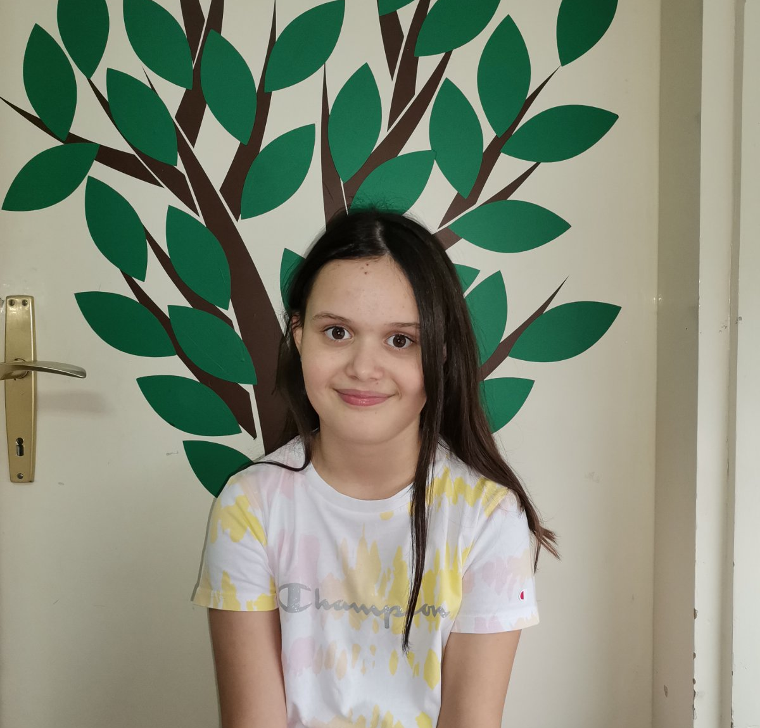
I wish my uncle to come from France. I also wish for more new friends in my village. I would like a new car for my family. Next wish is to visit Spain. And finally I wish to become a professional football player
I would like to be good at handball and playing piano. I wish for a new room and a trip to France.

Slide 16
Merry Christmas!!
Sretan Božić!

Slide 17
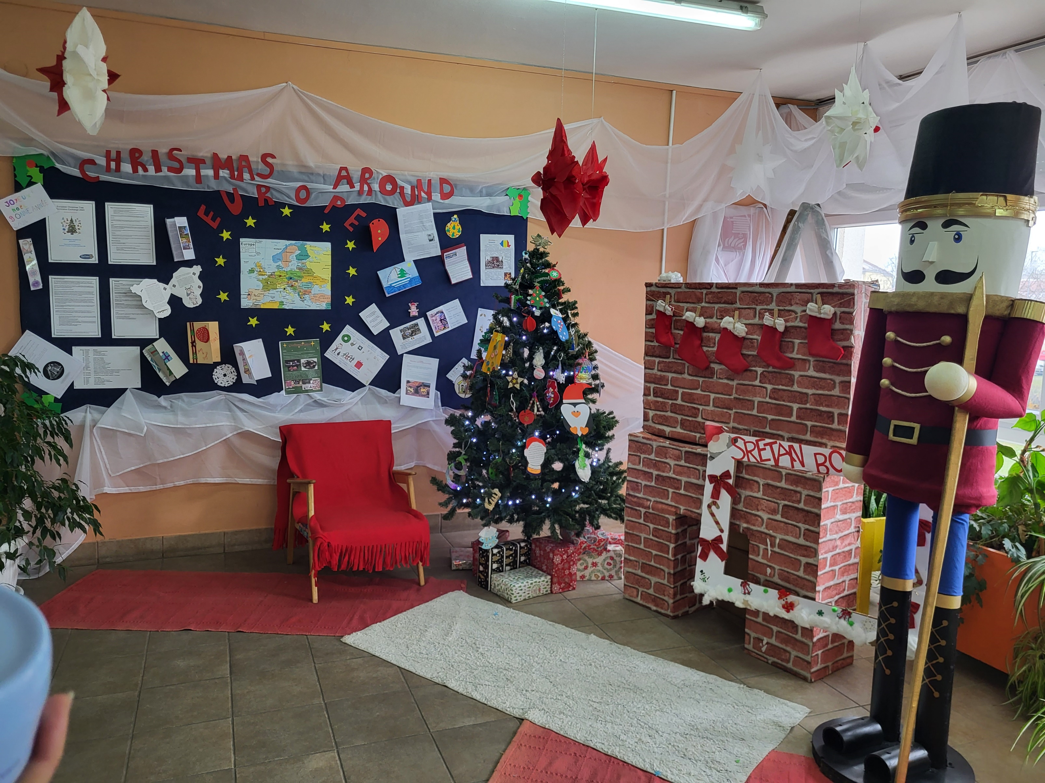

Slide 18
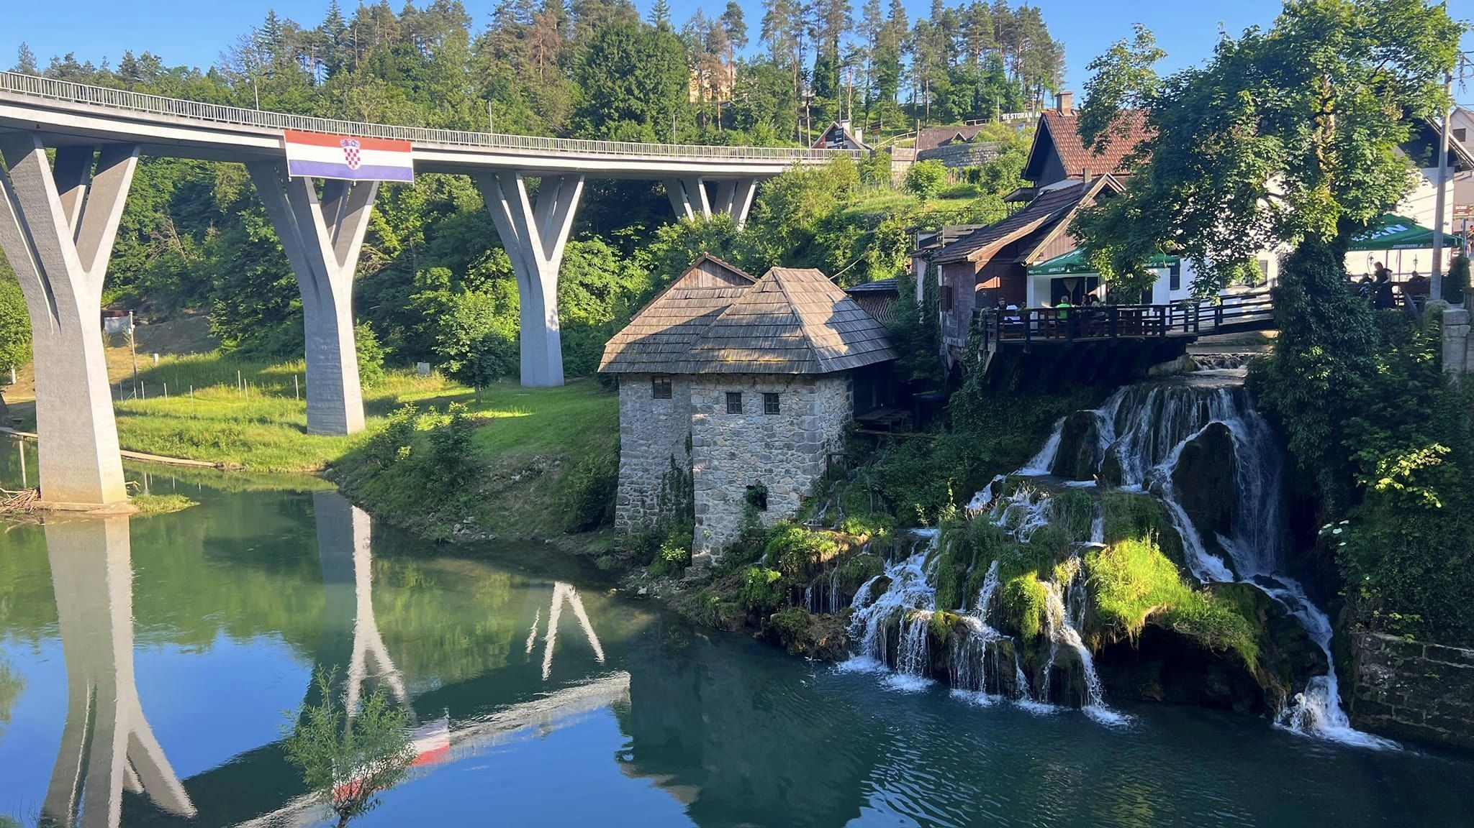
THE END

